Slide 1
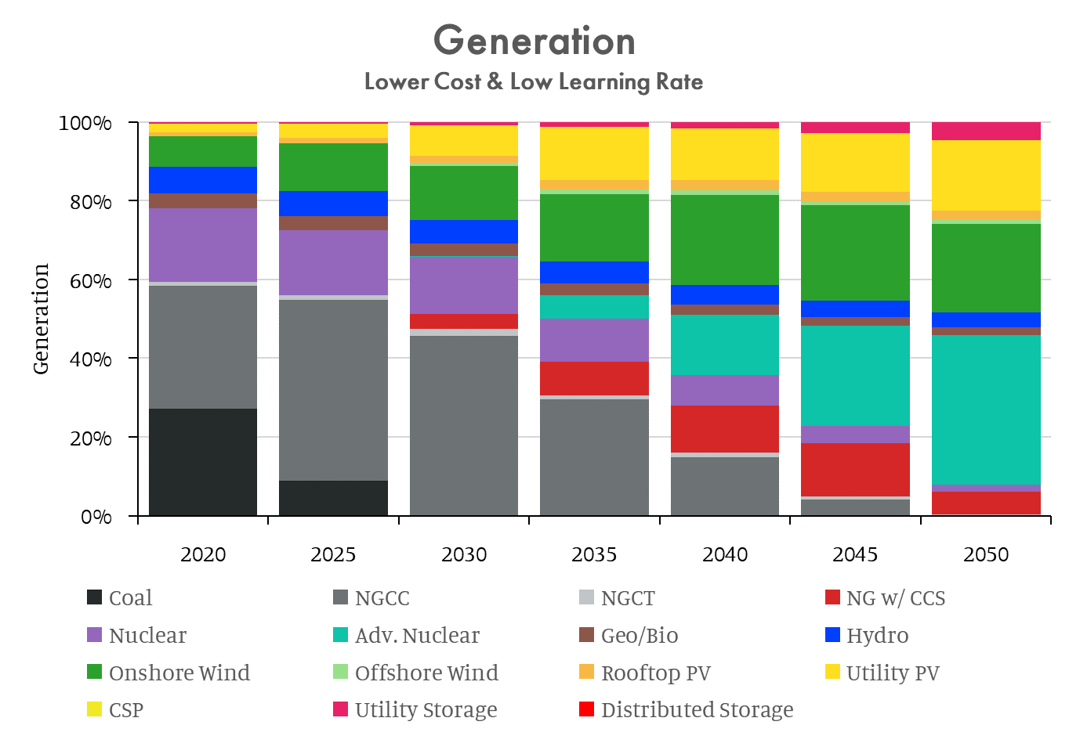
COLOR PALETTE
#94090D - Hydrogen
#FF0000 - Dist Storage
#E82269 - Util Storage
#FDFD4D - CSP
#FF7F0E - Rooftop Solar
#FFDE20 - Utility Solar
#98DF8A - Offshore Wind
#2CA02C - Onshore Wind
#003FFD- Hydro
#8C564B - Geo/Bio
#56a9d5 - HTGR
#0dc3a8 - ARTES
#0d4459 - SMR
#814DB1 - Nuclear
#D62728 - NG w/ CCS
#c0c6c8 - NGCT
#6d7374 - NGCC
#252a2b - Coal
If Advanced nuclear is combined use color for ARTES

